Slide 1
Thesis Writing
CSC 4195 Research Methodology
11 &12
6
FALL 2020-2021
Dr. Afroza Nahar, Associate Professor
Department of Computer Science, Faculty of Science & Technology.
afroza@aiub.edu

Slide 2
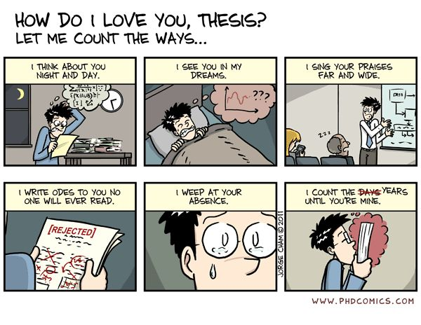
What is a Thesis?
A thesis is an original contribution to knowledge
It describes the complete process of the project starting from the problem formulation to the solution and conclusions in a Scientific and Methodical manner.

Slide 3
Thesis...
Exposition of original research in context
Constitutes objective evidence of the author’s knowledge and capabilities in the field of interest and is therefore a fair means to gauge them
Your thesis must show 2 (two) important things:
you have identified a worthwhile problem or question which has not been previously answered
you have solved the problem or answered the question.

Slide 4
Thesis...
A reader/reviewer will expect that:
you have identified a worthwhile problem or question which has not been previously answered
you have solved the problem or answered the question
A reader/reviewer will ask:
what is the research question?
is it a good question? (has it been answered before? is it a useful question to work on?)
did the author convince me that the question was adequately answered?
has the author made an adequate contribution to knowledge?

Slide 5
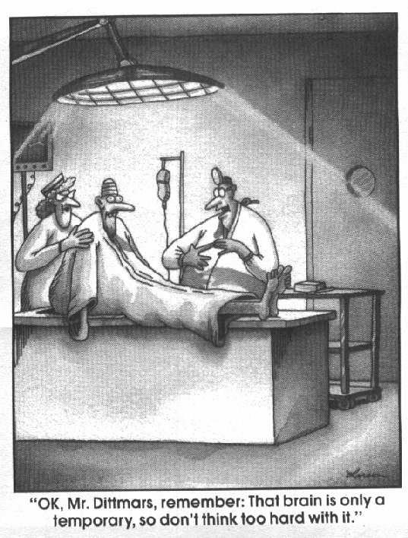
What a Thesis is Not?
What I did in the lab over the last 3 years
I first read the background material
I then implemented an algorithm
I ran some experiments
…
A thesis is a logical reconstruction
Not a historical narrative
A brain dump of everything you’ve done

Slide 6
Thesis vs. Dissertation
Thesis is usually associated with a full research mode degree
Dissertation is more common term for the research project required a degree by coursework
Western countries use the terms interchangeably

Slide 7
Attributes of Good Thesis
It should be contestable, proposing an arguable point with which people could reasonably disagree. A strong thesis is provocative; it takes a stand and justifies the discussion you will present.
It tackles a subject that could be adequately covered in the format of the project assigned.
It is specific and focused.
It clearly asserts your own conclusion based on evidence.

Slide 8
Attributes of Good Thesis…
It provides the reader with a map to guide him/her through your work.
It anticipates and refutes the counter-arguments
It avoids vague language (like "it seems").
It avoids the first person.
It should pass the “So What” or “Who Cares” test.
Specific topic + Argument = Thesis
What you plan to argue + How you plan to argue it = Thesis

Slide 9
Originality & Contribution
You must present a thorough review of the existing literature on the subject, and on closely related subjects.
Make direct reference to your literature review
You must demonstrate that your question
has not been previously answered
is worth answering

Slide 10
Structure of a Thesis
Introduction/Theme | Why am I doing this?
Literature Review | What is known? What is unknown?
Aims | What do/did I hope to find out?
Methodology | How is/was it found out?
Results | What did I find?
Discussion | What does it mean?
Conclusion | What is the significance? What applications? What to next?

Slide 11
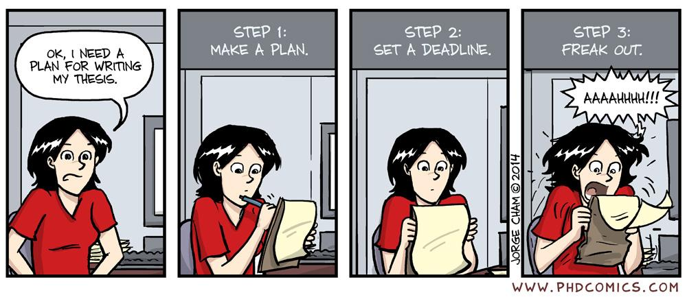
Planning the Thesis
Fieldwork, literature review, Interviews; Methodology (1 months)
Proof of Principle (2 months)
Data analysis and validation
Maintain notes (laboratory workbooks) [also keep notes on thoughts from the start]
A thesis takes about 180 mins a day

Slide 12
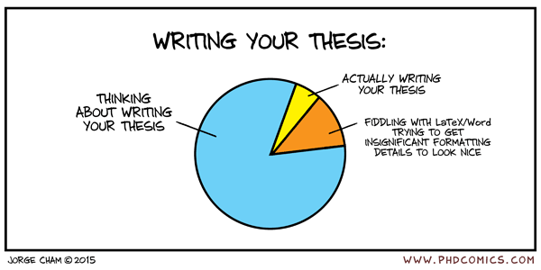
How long it takes to write thesis?
Longer than you think!!
It is wise to allow at least one complete term for writing the thesis
Writing the thesis requires the complete organization of your arguments and results
Fixing those weaknesses that takes time
Supervisors are sometimes not quick at reviewing and returning drafts
Bottom line: leave yourself enough time. A rush job has painful consequences at the defence.

Slide 13
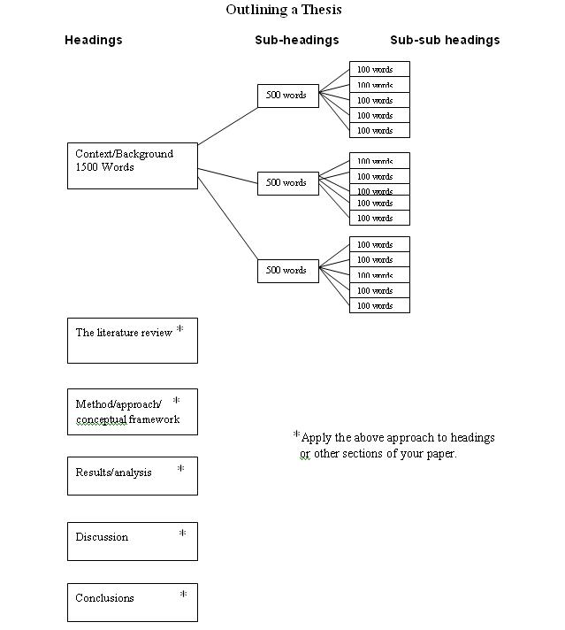

Slide 14
Developing the Thesis
Convert plan/argument into chapters
at least one chapter per sentence
perhaps more than one, sometimes
Develop a physical “structure”
set up folders for each chapter
have a plan for each chapter
Allow the plan to evolve
don’t be worried about changing
new results may require reinterpretations

Slide 15
Simple Structure of a Thesis
Convert plan/argument into chapters
at least one chapter per sentence
perhaps more than one, sometimes
Develop a physical “structure”
set up folders for each chapter
have a plan for each chapter
Allow the plan to evolve
don’t be worried about changing
new results may require reinterpretations

Slide 16
Simple Structure of a Thesis
The Bellman’s Rule of Three
Overall
Introduction – what the thesis says; context of the hypothesis
Body of the thesis – what makes the thesis
Conclusion – what the thesis said; what it means for future directions
Each chapter
Introduction – what this chapter says; where it sits in the theme
Body of the chapter – methods, results
Conclusion – what this chapter means; how it leads logically to the next

Slide 17
Simple Structure of a Thesis
Each paragraph
Introduction – broaches an idea; links to previous ideas
Body of the paragraph – describes the idea
Conclusion – concludes the idea (and links to next)
*Not just repetition – linking, theme, rationale, integration

Slide 18
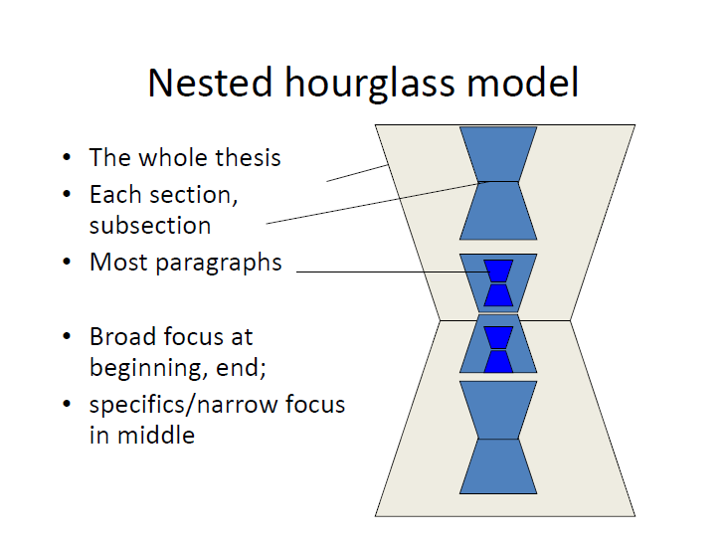
Nested Hourglass Model
The whole thesis
Each section, subsection
Most Paragraphs
Broad focus at the beginning and end
Specifics/narrow focus in the middle

Slide 19
Thesis Writing
CSC 4195 Research Methodology
12
6
FALL 2020-2021
Dr. Afroza Nahar, Associate Professor
Department of Computer Science, Faculty of Science & Technology.
afroza@aiub.edu

Slide 20
Abstract
Write this LAST!
Abstracts should not exceed 500 words
Should be self-contained
Written to attract readers to your article or thesis, gives a good initial impression
Summary of the contents of the thesis
Brief but contains sufficient detail
motivation for the work (problem statement)
project objectives
techniques employed
main results and conclusions

Slide 21
Thesis Content: Preface
Acknowledge
Table of Contents
List of Figures
List of Tables
List of Appendices
List of Symbols and Abbreviation

Slide 22
Introduction
Write this second to last!
You probably wrote this for your thesis proposal; REWRITE IT AFTER body of thesis is written
This is a general introduction to what the thesis is all about. Briefly summarize the question, and some of the reasons why it is a worthwhile question
The aims and objectives of the study
The scope or outline of the research approach
A description of the contents of each section

Slide 23
Background
A brief section giving background information may be necessary.
Your readers may not have any experience with some of the material needed to follow your thesis, so you need to give it to them.
A more informative title is usually better.

Slide 24
Literature Review
Provides context for and details about the motivation for the project
States why the problem is important
Sets the scene for the work described in the thesis
Describes what others have done and hence sets a benchmark for the current project
Justifies the use of specific techniques or problem solving procedures

Slide 25
Review: State-of-the-Art
Limited to the state of the art relevant to your thesis. Again, a specific heading is appropriate
The idea is to present (not analyze) the major ideas in the state of the art right up to, but not including, your own personal brilliant ideas.
You organize this section by idea, and not by author or by publication.
Do not simply quote or paraphrase the contents of published articles. Weave the information into focused views. Demonstrate your deeper understanding of the topic.
Do not be tempted to summarize everything you have read; only include those relevant to your main points

Slide 26
Research Question or Problem Statement
A concise statement of the question that your thesis tackles
Justification, by direct reference to previous work, that your question is previously unanswered. This is where you analyze the information which you presented in the “state of the art” section
Discussion of why it is worthwhile to answer this question.

Slide 27
Data & Interpretation
No standard form. But still organized!
One or several sections and subsections.
Methods, Data, Interpretation sections are separate
Only one purpose: to convince the advisor (reader/reviewer) that you answered the question or solved the problem stated in the previous section.
Present data that is relevant to answering the question or solving the problem:
if there were blind alleys and dead ends, do not include these, unless specifically relevant to the demonstration that you answered the thesis question.
Note for some theses it may be important to include these in an appendix

Slide 28
Research Methods
Depending on your topic this may be one paragraph or a long section
If measurement error is important to your study, state how this was assessed.

Slide 29
Data Presentation
Draft your figures first: (A picture is worth a thousand words)
Make captions stand alone
Use enough figures to present the data that justifies your interpretations and conclusions. No more, no less. (Don’t use 1000 words when 500 will do)
Write your text around your figures

Slide 30
Interpretation
Keep separate from data, clearly distinguished by paragraph, section, and/or words like “are interpreted to show”.
Depending on your topic, it is often useful to subdivide interpretation into a “local” or small scale (directly flows from your data) and a “regional” or “big picture” scale, that flows from consideration of your data with that of others. This latter type is usually included in the “discussion” section.

Slide 31
Discussion
Look at discussion sections in papers in your field. See what they cover.
Usually is a broader scale interpretation than just your data (relate to previous published results)
Addresses the bigger problems of your research topic and how your study fits into solving those problems
Is NOT a conclusion section

Slide 32
Conclusions
Summary of Contributions
Future Research
Conclusions are not a rambling summary of the thesis: they are short, concise statements of the inferences that you have made because of your work.
Organize conclusions as short numbered paragraphs, ordered from most to least important. All conclusions should be directly related to the research question stated

Slide 33
Use Proper Tools
Spreadsheets, analysis tools
Plotting programs
Graphics programs
ENDNOTE/RefMan/Mendeley/ProCite/LaTeX
Writing resources
Start learning these before you collect the data
Use turnitin.com to check the originality of text
END: G

Slide 34
References
All references cited, including those in Tables and Figure captions. No more, no less.
The references should be written consistently in the American Psychological Association (APA) or IEEE or any other format
Each reference should be written in single spacing format and a double space should be left between references.
Use ENDNOTE or any other program (start NOW building your library database)

Slide 35
References…
APA format:
http://www.bibme.org/citation-guide/apa/
IEEE format:
http://pitt.libguides.com/citationhelp/ieee
MLA format:
http://www.easybib.com/guides/citation-guides/mla-format/

Slide 36
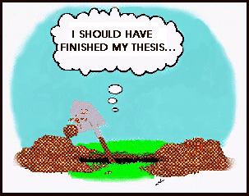
Writing
Some people never manage to write one
99% perspiration
1% inspiration?
If you’re lucky, your thesis will be read by:
Your supervisor
Your thesis committee

Slide 37
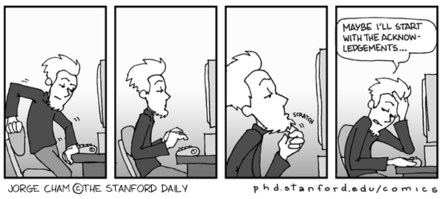
Writing…
This is the hardest part
Allocate 2 to 3 times the amount of time to writing as to gathering material
preparation for writing your thesis begins as soon as you start your research
Learn to draft and revise

Slide 38
Writing…
Keep a research log or series of short 'papers' explaining your work
Try to anticipate what you will need to produce as the final written account, and organise your records accordingly
Prepare and continually update a table of contents of your thesis
Analyse the data thoroughly and think actively about the interpretation of information as you proceed with your research
Start to do some writing as your research progresses

Slide 39
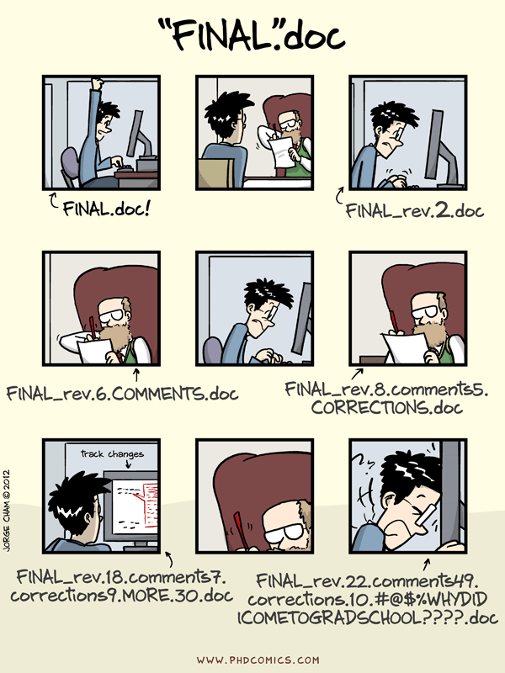
Writing…
Prepare an extended outline.
Use MS Word “outline” tool
List each section and subsection
For each section and subsection, write a brief point-form description of the contents.
Review with your advisor. Look for
unnecessary material? Remove it.
missing material? Add it
It is much less painful and more time-efficient to make such decisions early, during the outline phase, rather than after you've already done a lot of writing which has to be thrown away.

Slide 40
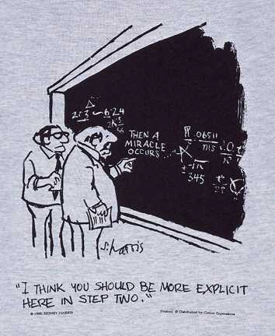
Writing…
Avoid ornate language, words you don’t really understand (look it up!)
Avoid convoluted writing
Shed light on your subject: clarity is everything

Slide 41
Writing…
Grammar and Sentence Structure
Use active constructions. For example, say “the operating system starts the device” instead of “the device is started by the operating system”
Write in the present tense.
Focus on results and not the people/circumstances in which they were obtained
Be careful to only draw conclusions that the evidence supports

Slide 42
Writing…
Don’t start with the Introduction or Conclusion
Start where you feel comfortable
Typically a middle chapter
Write outwards
Finally Conclusions and end with the Introduction
Write everything with your thesis message in mind
You’ll discover holes in your research
Theorems you haven’t proved
Experiments you didn’t run
Different problems or parameters
Mix writing with more research Sec H

Slide 43
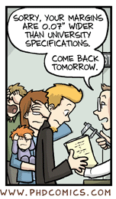
Format Specifications
Use single-sided, on high quality white A4 paper (201 × 297 mm; 80 grams)
font type Times New Roman, font size 12 (except for tables and figures) and justified
body of the text should be typed with double spacing.
Single-spacing is only permitted in tables, long quotations, footnotes, citation and in the references.

Slide 44
format…
Allow at least TWO days just to print and check your thesis - it really does take this long
Print a draft copy first and check for errors before printing final copies - get a friend or partner to proof-read the thesis to check for typos
Print one chapter at a time - don’t try to merge the thesis into one document and print it as a whole
Check each thesis copy to ensure that all the pages are numbered sequentially

Slide 45
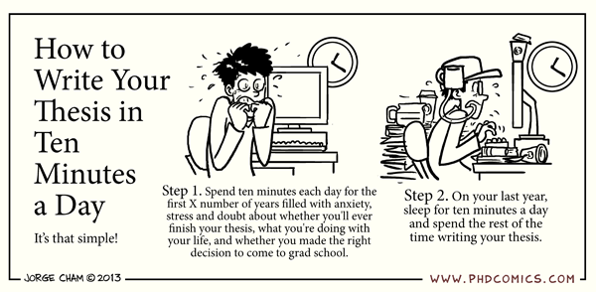
Problems with Writing
Problem 1: How do I plan? When do I plan?
The best way and time is at the beginning:
Confirmation, Progress Reports, laboratory books (diaries/journals) are all part of thesis writing

Slide 46
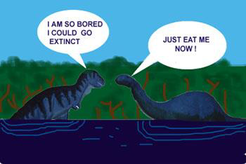
Problems with Writing…
Problem 2: I think I have writer’s block
work on manageable pieces
write down the main points – revisit your theme
you don’t have to write it in order
accept there are several drafts – get the ideas down
complex ideas may not be linear – draw a ‘concept map’
Leave the draft for a few days and come back later with a fresh look

Slide 47
Problems with Writing…
Problem 3 : I have trouble showing it is my idea
Recommended passive tenses can cloud attributions.
Don’t be afraid to play with sentence structure to get the idea across
practice expression and interpretation as a team.

Slide 48
Common Problems
It’s never possible to cover all issues
So you will never finish?
It’s sometimes enough to identify the issues
Examiners greatly appreciate you identifying limitations
Much of your thesis is joint work
Identify some work that is yours alone
Include a statement at the start of your contributions:
“Results from this thesis appear in the following publications. Whilst much of this thesis is joint work with my supervisor, I made significant contributions to Chapters 3-6. In particular, … . “

Slide 49
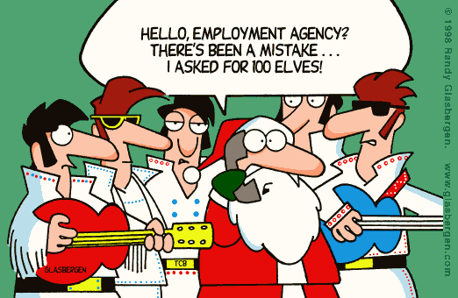
Common Mistakes
Informal text
Examiners will jump on imprecision
Opinions
“.. The main problem in CP is modelling ..”
A thesis is an argument!
“.. A major bottleneck preventing the uptake of CP is modelling [Freuder, AAAI-98]

Slide 50
Common Mistakes…
Avoid words:
bad, good, nice, terrible, stupid
Perfect – nothing is !!
would seem to show – what matters is the fact
Different – different than what?
lots of, kind of, just about vague and colloquial
The use of I, you, we – third person
Can/may
Avoid complex sentences full of long words
A thesis should be a simple, convincing argument!
Avoid entertainment or humour
oke footnote

Slide 51
What do Examiners Do?
Typical scan of a thesis
Abstract
Content Listing
Major Chapters
Conclusion
Figures
Introduction,
Literature Review
Finally, a quick read
Then –
Questions: Are they answered and/or considered?
Is any of it published?
Corrections: ..... ..... .....
11/30/2020

